Slide 1









GOLD SPONSORS
SILVER SPONSORS
BRONZE SPONSOR
STRATEGIC PARTNER

Slide 2
Design Myths
Dejan Sarka

Slide 3
Introduction
Dejan Sarka (dsarka@solidq.com, dsarka@siol.net, @DejanSarka)
30 years of experience
SQL Server MVP, MCT,…
16 books
15+ courses
Focus:
Data modeling
Data mining
Data quality

Slide 4
Storage Myth
Relational database is just a storage system
WRONG!
Relational database is the heart of IT systems
Relational model is about data integrity
A RDBMS enforces data integrity

Slide 5
Physical Myth
Knowing details of a RDBMS is very important
Design for performance, not for theory
WRONG!
Logical problems are more important that physical ones
Physical problems pass over
Relational model is a logical model
A good logical design should perform well; the opposite is not always true

Slide 6
Repeating Group Myth (1)
A table with repeating group of columns needs normalization (1st NF)
EMPLOYEES(EmpId, EmpName, Child1Name, Child2Name, Child3Name,...)
WRONG! Let‘s rename the table and the columns

Slide 7
Repeating Group Myth (2)
Repeating columns with similar names is not a repeating group!
Just a constraint built in the model
This is normalized:
ORDERS(OrderId, CustomerId, OrderDate, DueDate, ShipDate,...)
And this not?
EMPLOYEES(EmpId, EmpName, Child1Name, Child2Name, Child3Name,...)

Slide 8
Atomicity Myth
Every collection in a single column of a single row is a repeating group, is not atomic
WRONG!
We need to know the correct definition of atomicity
A value is atomic as long as you operate with it only with methods defined on the data type of the value (e.g. Datetime data)
XML and UDTs with collections are atomic!

Slide 9
Keys Myth
There are Natural and Surrogate key
WRONG!
There are only keys
Who defines what is natural, and what is not natural?
Slightly better definition: “A key is natural if it is used outside the database and application, in real life”
Stil not mathematical definition

Slide 10
Natural Keys Myth
If you do not have a natural key, you do not have a set
WRONG!
Just give me a set, any set!
A set is purely logical and abstract term
The one who defines the set, defines what makes elements unique as well
Also, do not forget on abstraction

Slide 11
Redundancy Myth
Normalization is about eliminating redundancy
Partially wrong
Normalization is about eliminating redundancy and incompleteness

Slide 12
SQL Language Myth
SQL language is essential for relational databases
WRONG!
The question of using relational model in a database is orthogonal to the question which language is supported by the RDBMS
The “D” language proposal (Date, Darwen)
Query By Example (QBE)

Slide 13
Truncate Table – DDL or DML?
Wikipedia: “In SQL, the TRUNCATE TABLE statement is a Data Definition Language (DDL) operation that marks the extents of a table for deallocation (empty for reuse)”
So it is DDL?
WRONG!
However: “The TRUNCATE TABLE mytable statement is logically (though not physically) equivalent to the DELETE FROM mytable statement (without a WHERE clause)”
In a relational model, we are manipulating with data on the logical level; the physical implementation is left to the database management system
So TRUNCATE TABLE is DML!

Slide 14
ALTER TABLE SWITCH – DDL or DML?
Syntax is DDL
SQL Server changes system pages
So it is DDL?
WRONG!
However, logically, you just move the data from one table or partition to another table or partition
You do not change the schema at all
Therefore, semantically, this is a DML statement

Slide 15
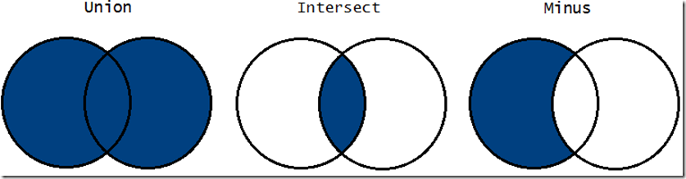
Set Operators (1)
UNION, INTERSECT and EXCEPT operators are commonly called Set Operators
Represented by Venn diagrams
Partially WRONG!

Slide 16
Set Operators (2)
Set operators work on sets and produce a set
Relational operators work on relations and produce a relation; SQL operators UNION, INTERSECT and EXCEPT produce relations
So they are relational operators!

Slide 17
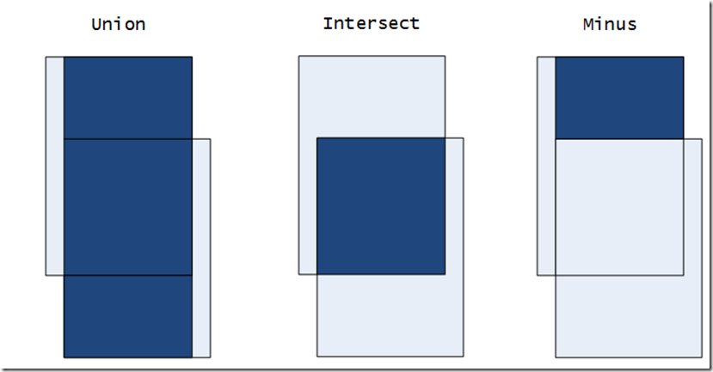
Set Operators (3)
Need to change the presentation!

Slide 18
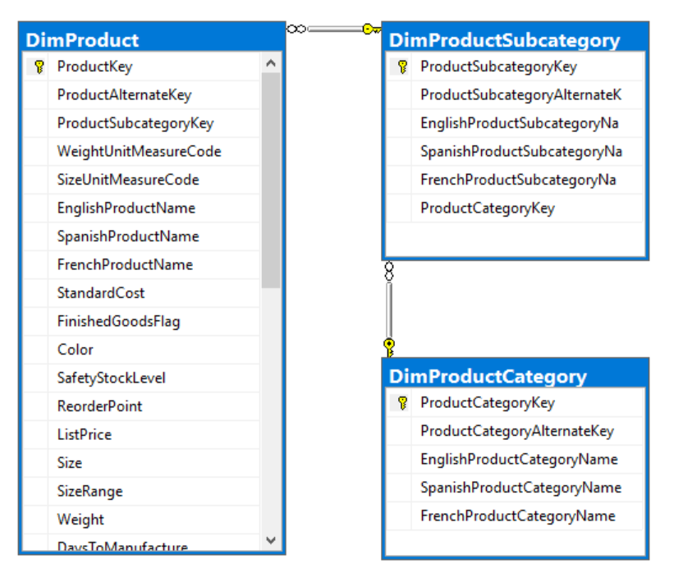
Denormalization Myth (1)
Star schema is denormalized
Not necessary
Dimension are denormalized only if you have rigid attribute relationships in natural hierarchies

Slide 19
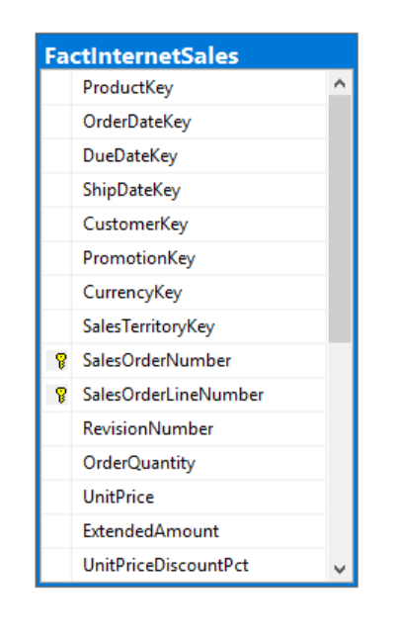
Denormalization Myth (2)
Star schema is denormalized
Not necessary
Transaction fact tables are denormalized only if you include degenerate dimensions

Slide 20
Fact Table Myth
Fact table is called fact table because it holds facts
Yes, but... but... but...
Don’t all tables hold facts?
Fact tables should have different name
Central tables, for example

Slide 21
SCD Myth
There are three solutions for the SCD problem (type 1, type 2, type 3)
WRONG!
There are more and better solutions
Create another dimension from the type 2 attributes, and leave them in the original dimension as well
Scalable solution that encompasses both type 1 and type 2

Slide 22
Another SCD Solution
Gives possibility to analyze the data as if you would have type 1 (through original dimension) or type 2 (through new dimension)

Slide 23
Class-Table Myth
A class is the same thing as a table
WRONG!
A class is the same thing as a domain (data type)
The definitions are the same
Relational model is not limited to “simple” types
Relational model allows “typed” tables

Slide 24
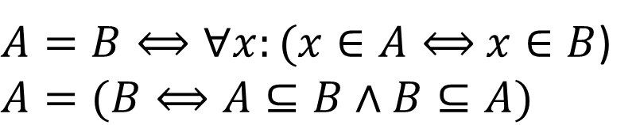
Table-Class Myth
A table is the same thing as a class
WRONG!
A table is a variable
It behaves like a variable (logically, of course)
Update means replacing on set with another
Set equality:
$A=B⟺∀x:(x∈A⟺$ $x∈B$)
$$A=(B⟺A⊆B∧B⊆A)$$

Slide 25
Subtype Myth
A subtype is the same thing as a subclass
WRONG!
What is inherited by a subclass?
What is inherited by a subtype?

Slide 26
Think Set Oriented – Running Total
What does set oriented mean for a running total?
Cursor
Self join
Window aggregate function
Which of that is set oriented?
Which of that is good?
A cursor is better than a self join
WAF syntax is leading to an inefficient thinking!
Partition | Value | Running Sum | Frame
AA | 1 | 1
AA | 1 | 2
AA | 1 | 3
AA | 1 | 4
AA | 1 | 5
BB | 2 | 2
BB | 2 | 4
BB | 2 | 6
BB | 2 | 8
BB | 2 | 10

Slide 27
Thing Set Oriented – For Each Loop
Performing an action for each row in a rowset is not set oriented
That is why we don‘t have this loop in T-SQL
But… but… but…
The APPLY operator does something for each row from the left rowset input!

Slide 28
Myth above All Myths
In this room, there are people who can drink more beer and schnapps than your speaker
Maybeeee......
But it has to be proven!
Thank you and see you with the beer!

